Slide 1
Insertion sort
Course Code: CSC 2106
Course Title: Data Structure (Theory)
Dept. of Computer Science
Faculty of Science and Technology
Lecturer No: | 5.2 | Week No: | 5 | Semester:
Lecturer: | Name & email

Slide 2
Lecture Outline
Insertion Sort

Slide 3
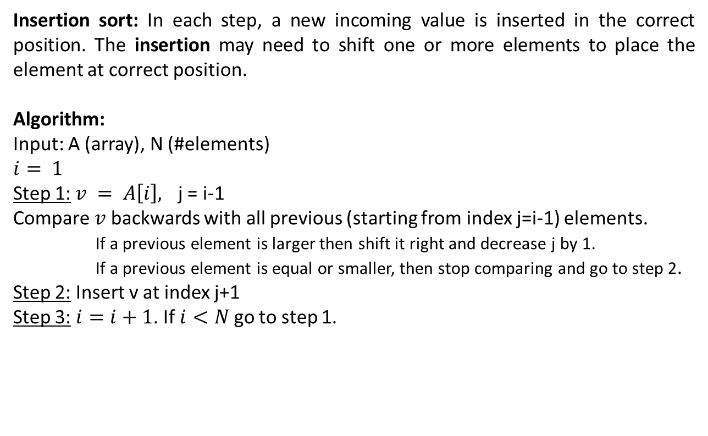
Sorting
Insertion Sort
Insertion sort: In each step, a new incoming value is inserted in the correct position. The insertion may need to shift one or more elements to place the element at correct position.
Algorithm:
Input: A (array), N (#elements)
$$i= 1$$
Step 1:$v = A\left[i\right],$ j = i-1
Compare$v$backwards with all previous (starting from index j=i-1) elements.
If a previous element is larger then shift it right and decrease j by 1.
If a previous element is equal or smaller, then stop comparing and go to step 2.
Step 2: Insert v at index j+1
Step 3: $i=i+1$. If $i<N$ go to step 1.

Slide 4
Insertion Sort
Simulation
i
i
i
i
i
i
i
i
i
j
j
j
j
j
j
j
j
j
j
66
22
99
77
11
91
55
88
44
v
22
11
33
66
33
22
66
33
22
77
66
55
44
99
77
99
77
66
55
99
91
77
66
11
99
91
88
77
91
55
99
91
88
88
99
91
44
99
0
1
2
3
4
5
6
7
8
9

Slide 5
Sorting
Exercise
Apply different sorting algorithms (Bubble, Selection and Insertion) to sort the below array. Show step by step simulation.
Also find the number of comparisons, shifting or swapping for each case.
32 | 12 | 67 | 33 | 22 | 88 | 44 | 25

